Slide 1
Lab 3

Slide 2
A photo album using PHP
Create a page named photos.php to display your photos
Your PHP page should dynamically list the photos

Slide 3
Lab 3
Create the following folder in your directory on Design Center’s machine
http://students.engr.scu.edu/~<username>/photo
Place several photos in the folder
The name of a photo file should indicate the content of the photo, e.g., “sunshine.jpg”

Slide 4
Lab 3
Write PHP code that looks for the names of all the photo files in this folder (Hint: use glob function)
Print each file name as a li list item with the class of photoitem

Slide 5
Lab 3
Make each item display just the photo file name, e.g., sunshine.jpg, without the prefix (Hint: use the basename function to extract the file name from a larger path string)
Make each item be a link to that photo

Slide 6
Lab 3
Display the size of each photo file in kilobytes. You can get the size of a file in bytes using the filesize(filename) function
Use round() to round decimal numbers to whole numbers

Slide 7
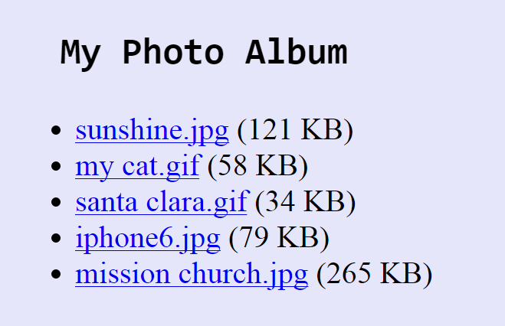
Lab 3
Your photo album should look like this
When add or delete any photo, the PHP page would reflect the change

